Slide 1
Neo4j and Graph Databases
Brain-Food Friday
April 1, 2016
Github: https://github.com/brbarnett/Neo4jBff

Slide 2
Agenda
What on earth is a Graph Database, and why would I use it?
My first Graph Database: setting up Neo4j
I can’t believe it’s not SQL
OK I get it, but how do I actually use it?

Slide 3
What is a Graph Database?
In computing, a graph database is a database that uses graph structures for semantic queries with nodes, edges and properties to represent and store data. - Wikipedia
Notes:
Nodes
Relationships as first class citizens
Dynamic data structure
What does this all mean? Let’s look at definitions of other DB types first…

Slide 4

Database type: RDBMS
Definition
A Relational Database Management System (RDBMS) is a tabular data store that allows cross-references to constrain and relate records between tables. Think spreadsheets on steroids. As of the time of this presentation, it is the most common database format in use.
When to use
Known problems
Well-structured data model
Normalization is key
Strong security requirements
Common implementations
MS SQL Server
Oracle Database
MySQL
Notes:
Tabular
Rigid schema
Referential integrity
Security

Slide 5

Database type: NoSQL
Definition
A NoSQL database is a mechanism for storage and retrieval of data which is modeled in means other than the tabular relations used in relational databases. This is more analogous to files within folders in a filing cabinet.
When to use
Speed is king
Rapid prototyping
Flexible schema
Common implementations
MongoDB
Redis
Cassandra
CouchDB
Notes:
Fluid data schema
Great for rapid development
Speed: pre-computed view models

Slide 6

Database type: Graph
Definition
A Graph Database is a database that stores entities (nodes) that may be connected by one or more relationships to enable querying via pattern matching.
When to use
Dynamic requirements
Data is highly-related
When relationships add valuable meaning
Data topology that is tough to predict
Common implementations
Neo4j
OrientDB
AllegroGraph
Notes:
Nodes with labels
Relationships as first class citizens
Key-value stores
Highly-related data where joins are extremely common

Slide 7



The database continuum
Discrete Data
Connected Data
Self-contained data documents that are indexed for lookups, providing extremely fast read/write capability. Databases are more BASE-ic to promote speed.
Joins and relationships are not only meaningful, but are considered as actual data records. Database ACIDity crucial to maintain consistency.
Atomic
Consistent
Isolated
Durable
Basic Availability
Soft-state
Eventual consistency
Notes:
Atomic
All operations in a transaction succeed or every operation is rolled back.
Consistent
On the completion of a transaction, the database is structurally sound.
Isolated
Transactions do not contend with one another. Contentious access to data is moderated by the database so that transactions appear to run sequentially.
Durable
The results of applying a transaction are permanent, even in the presence of failures.
Basic Availability
The database appears to work most of the time.
Soft-state
Stores don’t have to be write-consistent, nor do different replicas have to be mutually consistent all the time.
Eventual consistency
Stores exhibit consistency at some later point (e.g., lazily at read time).

Slide 8


Graph Use Case: Workplace Hierarchy
:Employee
:WORKS_FOR
:WORKS_FOR
:WORKS_FOR
:Employee
:Employee
:LOCATED_IN
:WORKS_FOR
:LOCATED_IN
:Office
:Office
Notes:
Match and flex
No “table seeks” or “scans”
Millions of pointer hops per second

Slide 9
Graph Use Case: Six Degrees of…
:Person
1st Degree
:KNOWS
:KNOWS
:Person
:KNOWS
2nd Degree
3rd Degree

Slide 10
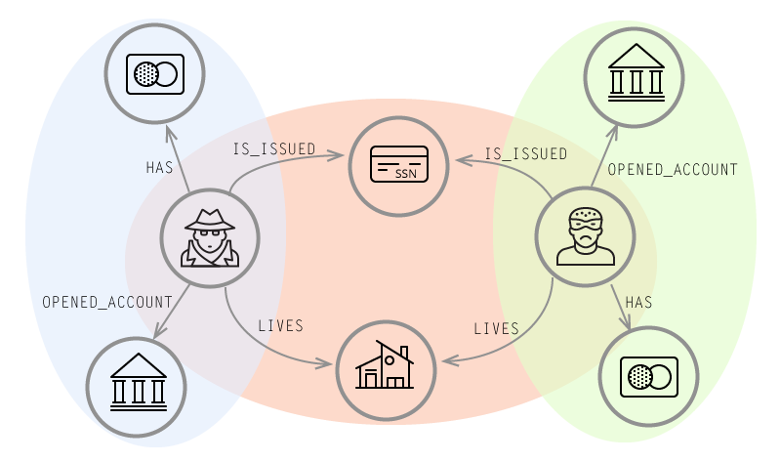
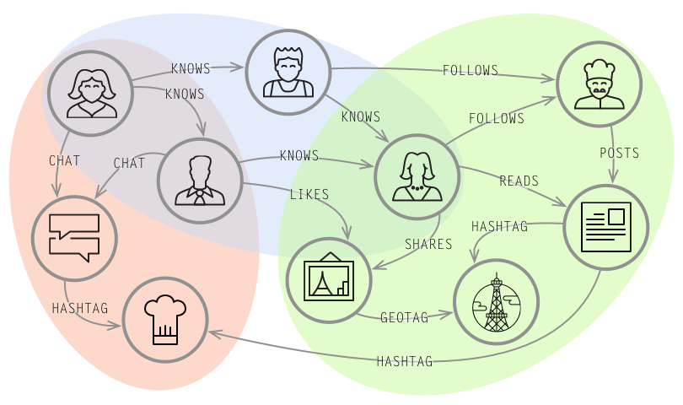
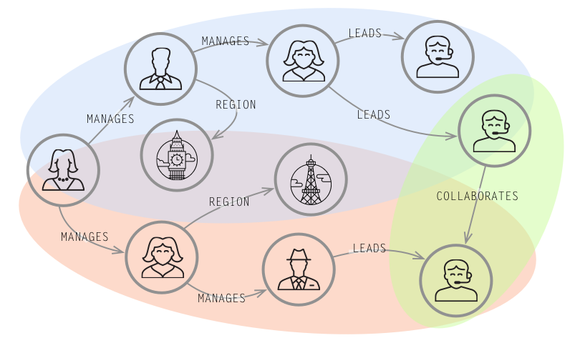
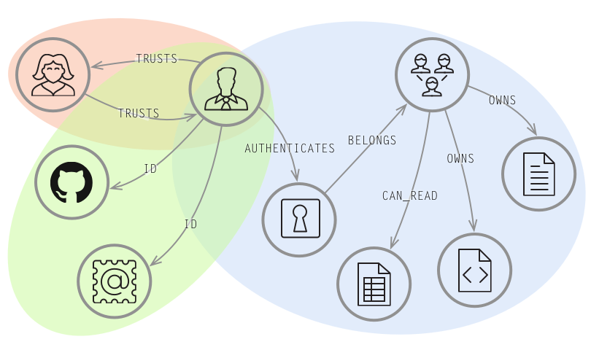
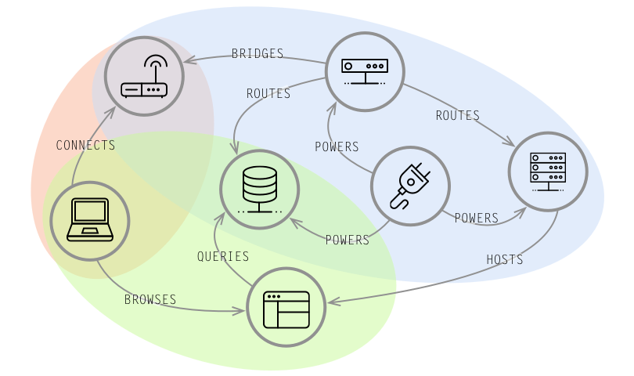
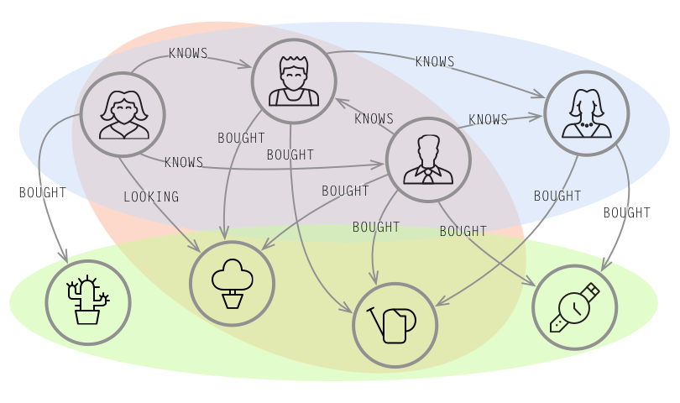
Other common use cases
Fraud Detection
Social Network
Master Data Mgmt
Identity and Access Mgmt
Network and IT Ops
Real-Time Recommendations

Slide 11
Installing Neo4j
Prevailing leader in the Graph Database market

Slide 12
http://neo4j.com/download/
Download Community Edition (Free)

Slide 13
Cypher
(p:Person { name: ‘Brandon’ })-[:Likes]->(l:Language { name: ‘Cypher’ })

Slide 14
The Basics of Cypher
Syntax
SQL-inspired and ASCII-based
Nodes are drawn with parentheses
Relationships are drawn with square brackets, and can be uni- or non-directional
Labels (nodes) or Relationship Types (relationships) are drawn as :Label
( ) – [ ] – ( )
( ) – [ ] -> ( )
( ) <- [ ] – ( )
CREATE (m:Movie { name: ‘Deadpool’ })
MATCH (a:Actor)-[r:ACTED_IN]->(m:Movie)
WHERE m.Movie = ‘Deadpool’
RETURN a, r, m
Notes:
Tend to resemble whiteboarding result

Slide 15
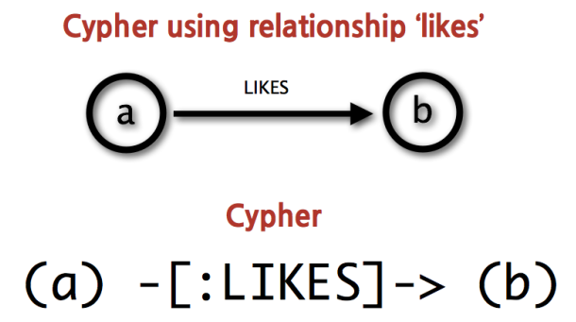
Cypher Demo
Notes:
Demo

Slide 16
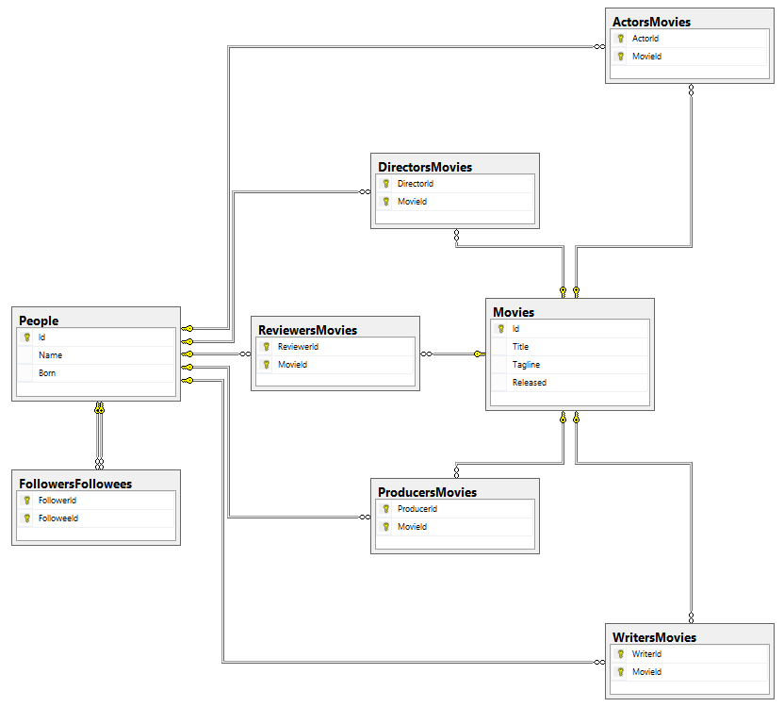
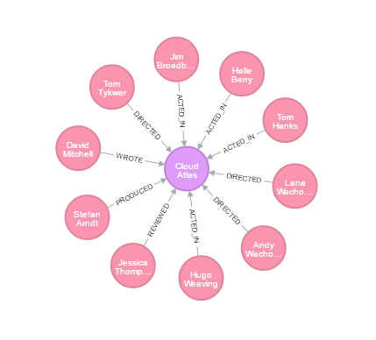
Schema Rigidity

Slide 17
Other Thoughts
Scale
Clustering/cache sharding
High-availability master-slave protocol
In-memory page cache
Hot backups
Licensing
Per instance licensing + support
Starts at ~$80K/yr for 1 prod, 1 test instance

Slide 18
Thanks

